Slide 2
Photo by Aaron Burden - Creative Commons No known copyright restrictions https://unsplash.com/@aaronburden?utm_source=haikudeck&utm_medium=referral&utm_campaign=api-credit
Created with Haiku Deck

Slide 3
Photo by Nikolas Noonan - Creative Commons No known copyright restrictions https://unsplash.com/@nikolasnoonan?utm_source=haikudeck&utm_medium=referral&utm_campaign=api-credit
Created with Haiku Deck

Slide 4
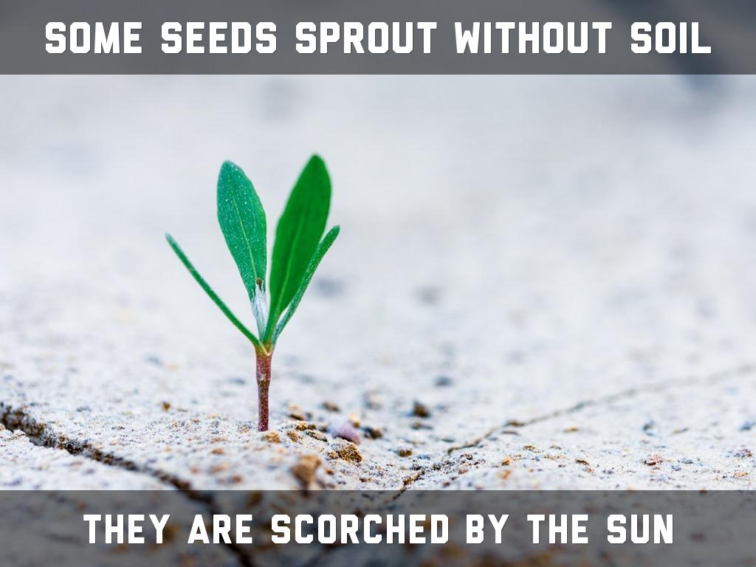
Photo by Stas Ovsky - Creative Commons No known copyright restrictions https://unsplash.com/@technobulka?utm_source=haikudeck&utm_medium=referral&utm_campaign=api-credit
Created with Haiku Deck

Slide 5
Photo by Alexandra E Rust - Creative Commons Attribution License https://www.flickr.com/photos/69670601@N05
Created with Haiku Deck

Slide 6
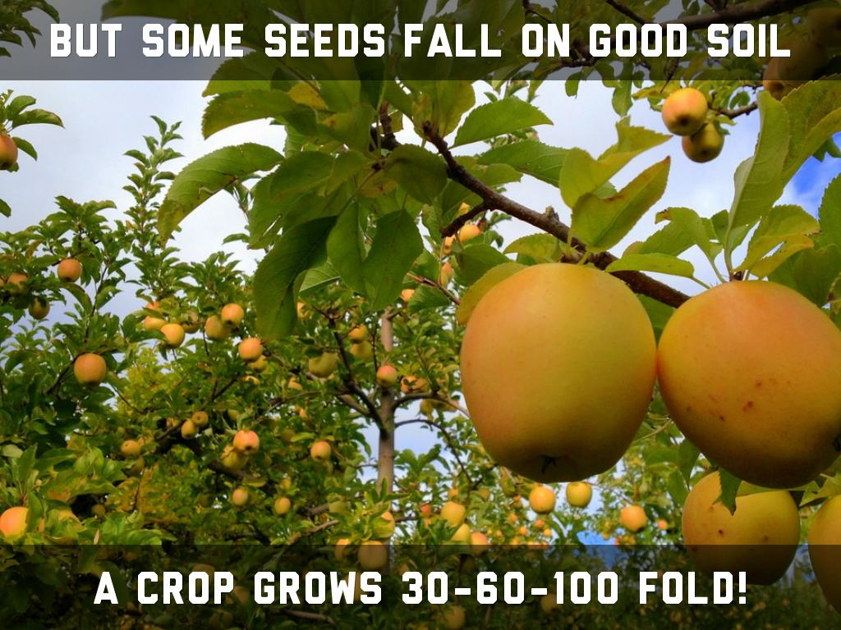
Photo by La.Catholique - Creative Commons Attribution License https://www.flickr.com/photos/38559542@N02
Created with Haiku Deck

Slide 7
Photo by Stefan Baudy - Creative Commons Attribution License https://www.flickr.com/photos/92454606@N00
Created with Haiku Deck

Slide 11
Photo by EJP Photo - Creative Commons Attribution-NonCommercial-ShareAlike License https://www.flickr.com/photos/29498428@N00
Created with Haiku Deck

Slide 12
Photo by hiyori13 - Creative Commons Attribution-ShareAlike License https://www.flickr.com/photos/36484111@N00
Created with Haiku Deck

Slide 13
Photo by Arry_B - Creative Commons Attribution-NonCommercial-ShareAlike License https://www.flickr.com/photos/38028162@N06
Created with Haiku Deck

Slide 14
Photo by Yanapi Senaud - Creative Commons No known copyright restrictions https://unsplash.com/@yaanapi?utm_source=haikudeck&utm_medium=referral&utm_campaign=api-credit
Created with Haiku Deck

Slide 15
Photo by Drriss & Marrionn - Creative Commons Attribution-NonCommercial-ShareAlike License https://www.flickr.com/photos/61943224@N04
Created with Haiku Deck

Slide 16
Photo by WanderingtheWorld (www.ChrisFord.com) - Creative Commons Attribution-NonCommercial License https://www.flickr.com/photos/44028103@N07
Created with Haiku Deck

Slide 17
Photo by Outdoor Traveler - Creative Commons Attribution-NonCommercial-ShareAlike License https://www.flickr.com/photos/57084067@N07
Created with Haiku Deck

Slide 18
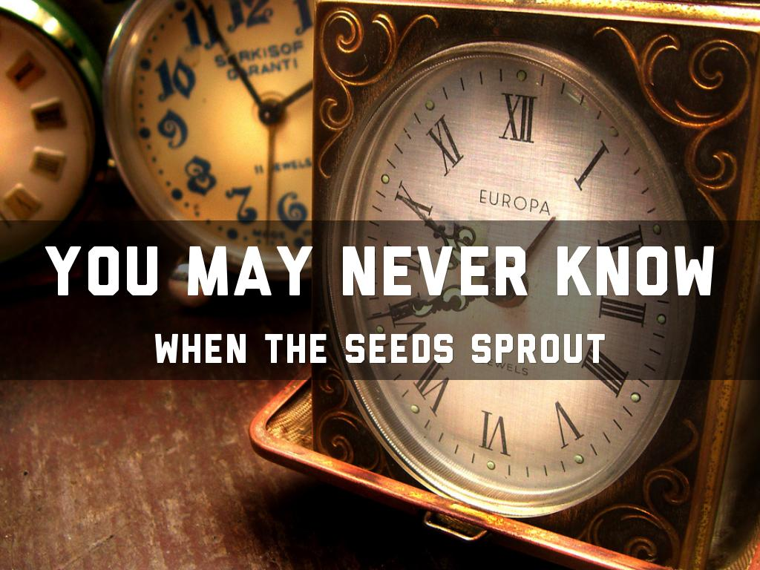
Photo by becosky... - Creative Commons Attribution-ShareAlike License https://www.flickr.com/photos/33143845@N07
Created with Haiku Deck

Slide 19
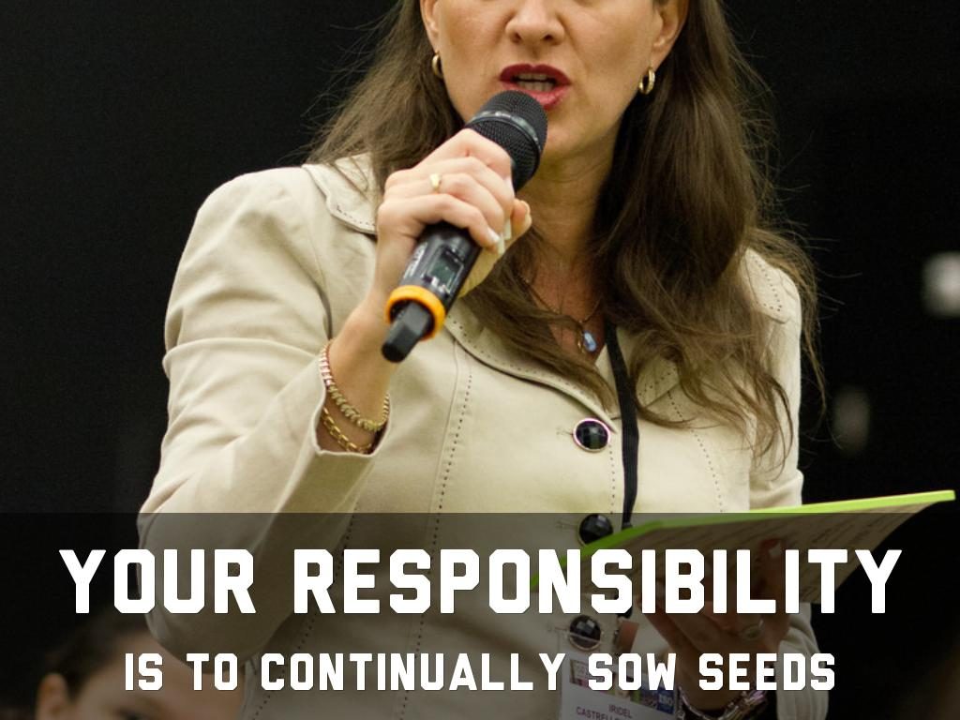
Photo by isostandards - Creative Commons Attribution-NonCommercial-ShareAlike License https://www.flickr.com/photos/48699820@N06
Created with Haiku Deck

Slide 20
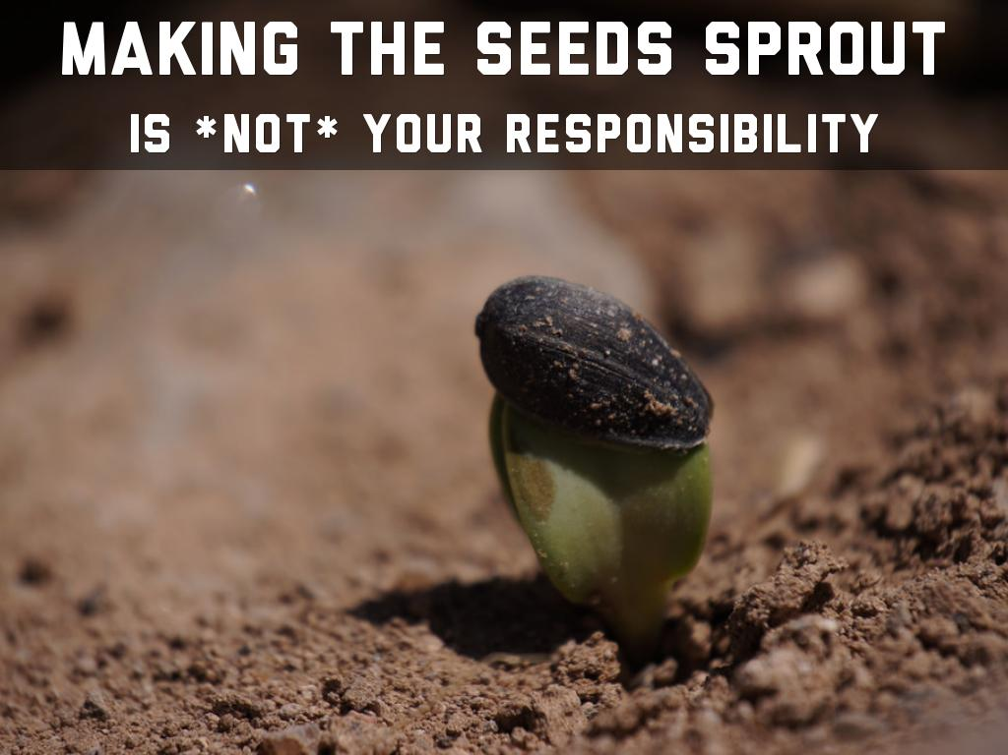
Photo by ikewinski - Creative Commons Attribution License https://www.flickr.com/photos/73449134@N04
Created with Haiku Deck

Slide 21
Photo by cellar_door_films - Creative Commons Attribution-NonCommercial-ShareAlike License https://www.flickr.com/photos/54474727@N00
Created with Haiku Deck

Slide 22
Photo by Okinawa Soba (Rob) - Creative Commons Attribution-NonCommercial-ShareAlike License https://www.flickr.com/photos/24443965@N08
Created with Haiku Deck

Slide 23
Photo by rawpixel - Creative Commons No known copyright restrictions https://unsplash.com/@rawpixel?utm_source=haikudeck&utm_medium=referral&utm_campaign=api-credit
Created with Haiku Deck

Slide 24
Photo by John-Mark Smith - Creative Commons No known copyright restrictions https://unsplash.com/@mrrrk_smith?utm_source=haikudeck&utm_medium=referral&utm_campaign=api-credit
Created with Haiku Deck

Slide 25
Photo by Okinawa Soba (Rob) - Creative Commons Attribution-NonCommercial-ShareAlike License https://www.flickr.com/photos/24443965@N08
Created with Haiku Deck

Slide 26
Photo by @Doug88888 - Creative Commons Attribution-NonCommercial-ShareAlike License https://www.flickr.com/photos/29468339@N02
Created with Haiku Deck

